Slide 1
A Pokémon Quest
Nikash Das

Slide 2


Problem statement – Image Recognition
Is it possible to use sprite data to classify Pokémon?
Can it classify Pokémon through generations?

Slide 3




Data set
Sort into folders
Pokemon Dataset
------ gen1
------------yellow
-----------------1.png
Raw sprite data of 2D games: https://veekun.com/dex/downloads
Preprocessing at runtime:
Grayscale
Resize (40 x 40)
Create csv file programmatically
gen | game | path | pokedex
gen1 | yellow | gen1/yellow/151.png | 151
gen2 | crystal | gen2/crystal/245.png | 245
gen3 | emerald | Gen3/emerald/376.png | 340

Slide 4


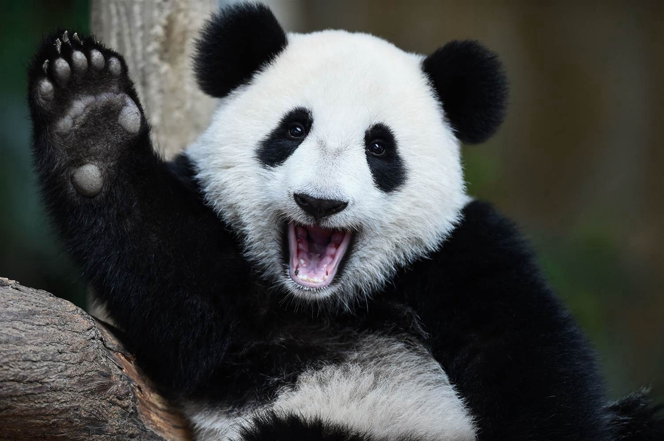
Keras Model -https://github.com/nykash/WhatsThisPokemon
Libraries:
Tensorflow and Keras for training
OpenCV (cv2) for image processing
Pandas for loading and saving csv files
Four convolution layers
200 hidden units
No dropout or batch norm
Output dimensions vary
50 epochs
RMSProp optimizer
Categorical Cross-entropy loss

Slide 5
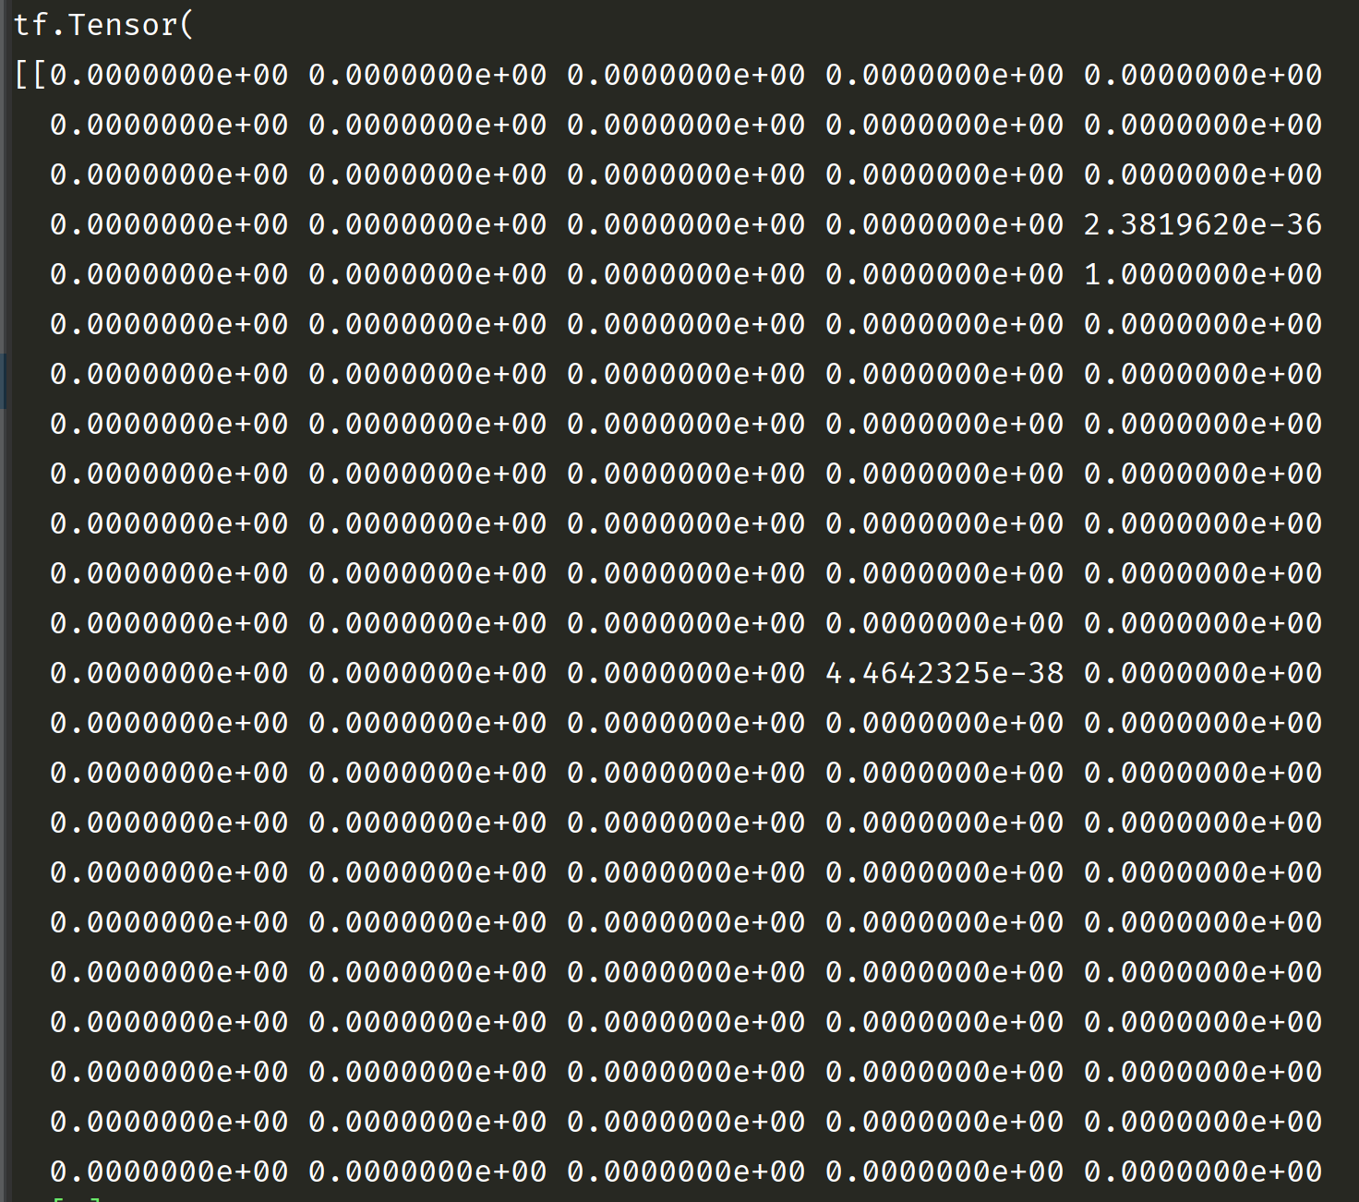
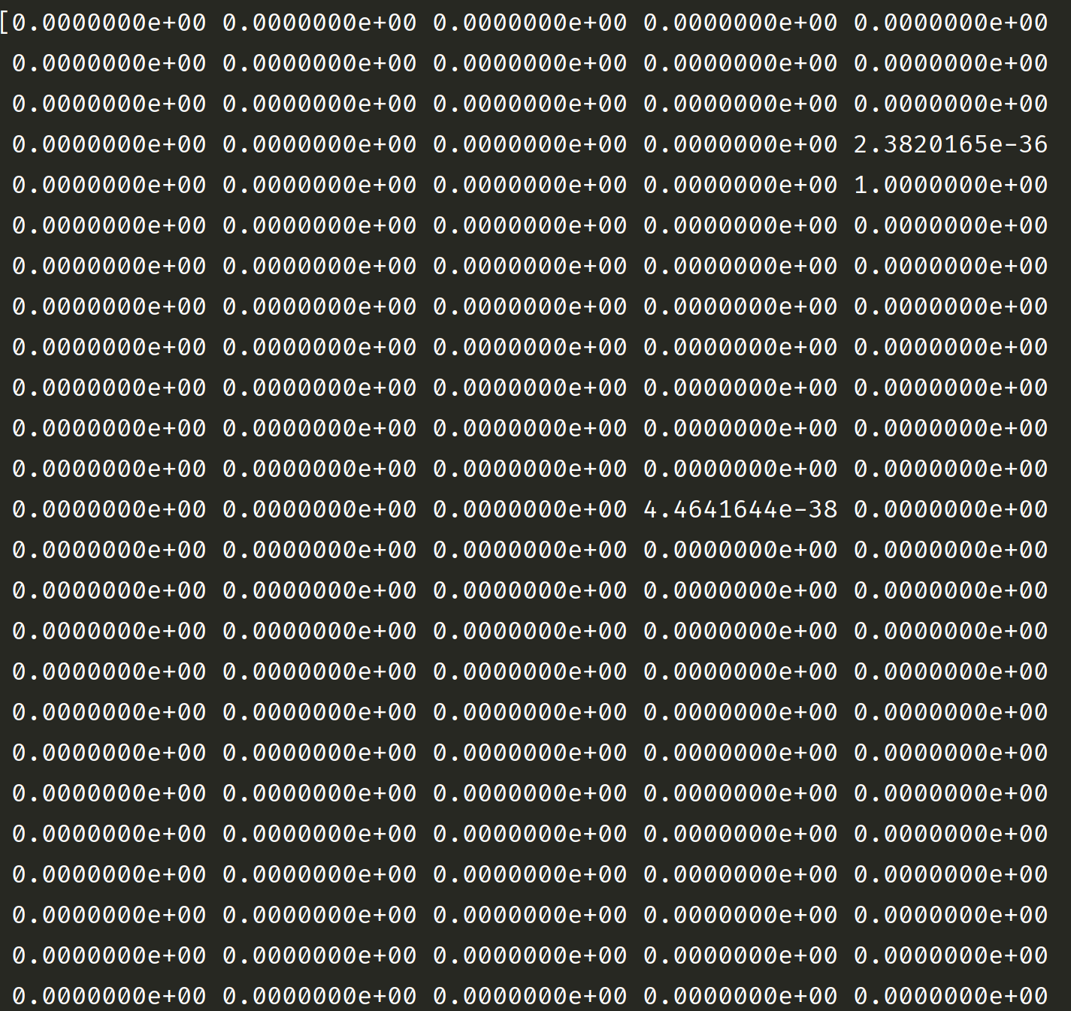
Example of Output

Slide 6
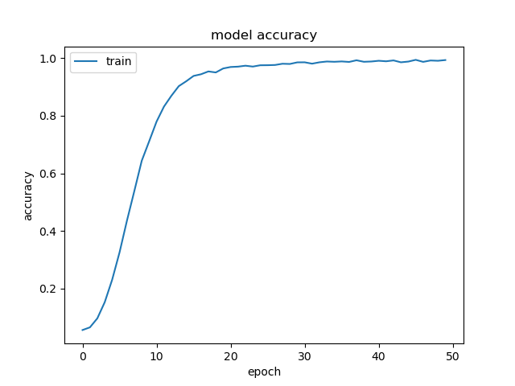
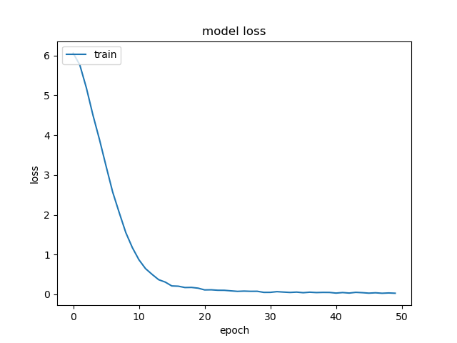
Results
Training session took <2 hours
Accuracies for all models were around 98% accurate on our gen 5 test set!
Models could identify Pokémon cross generations!

Slide 7
Lessons learned
Learned how to handle data in weirder formats
Learned more about the advantages/disadvantages of PyTorch vs Tensorflow
Tensorflow is faster to implement
Tensorflow is more friendly when doing basic structures
Ex// cnns
PyTorch excelled at feature engineering/preprocessing
PyTorch datasets API were easy to load, create, and use
PyTorch models had a lot of bugs
Hard to fix bugs
Example: transform function ToTensor messed up image data

